Slide 1
Maximum Flow
Lecture 3

Slide 2
Introduction
The max flow problem is a classic optimization problem in graph theory that involves finding the maximum amount of flow that can be sent through a network of pipes, channels, or other pathways, subject to capacity constraints.
It is used to model a wide variety of real-world situations,
such as transportation systems, communication networks, and resource allocation.
The maximum flow problem can be seen as a special case of more complex network flow problems,
such as the circulation problem.
The maximum value of an s-t flow (i.e., flow from source s to sink t) is equal to the minimum capacity of an s-t cut
(i.e., cut severing s from t) in the network, as stated in the max-flow min-cut theorem.

Slide 3
History
The maximum flow problem was first formulated in 1954 by T. E. Harris and F. S. Ross as a simplified model of Soviet railway traffic flow.
In 1955, Lester R. Ford, Jr. and Delbert R. Fulkerson created the first known algorithm, the Ford–Fulkerson algorithm.
In their 1955 paper, Ford and Fulkerson wrote that the problem of Harris and Ross is formulated as follows
Consider a rail network connecting two cities by way of a number of intermediate cities, where each link of the network has a number assigned to it representing its capacity. Assuming a steady state condition, find a maximal flow from one given city to the other.
Over the years, various improved solutions to the maximum flow problem were discovered,
Notably the shortest augmenting path algorithm of Edmonds and Karp and independently Dinitz;
The blocking flow algorithm of Dinitz;
The push-relabel algorithm of Goldberg and Tarjan;
and the binary blocking flow algorithm of Goldberg and Rao.

Slide 4
The Max Flow Problem
In the max flow problem, we have a directed graph with a source node s and a sink node t.
Each edge has a capacity that represents the maximum amount of flow that can be sent through it.
The goal is to find the maximum amount of flow that can be sent from s to t, while respecting the capacity constraints on the edges.
Maximum Flow: It is defined as the maximum amount of flow that the network would allow to flow from source to sink.
Two major algorithms to solve these kind of problems are Ford-Fulkerson algorithm and Dinic's Algorithm.

Slide 5
Ford-Fulkerson Algorithm
The Ford-Fulkerson algorithm solves the maximum flow problem for a directed graph.
The flow comes from a source vertex (s) and ends up in a sink vertex (t), and each edge in the graph allows a flow, limited by a capacity.
The Ford-Fulkerson algorithm works by looking for a path with available capacity from the source to the sink (called an augmented path),
and then sends as much flow as possible through that path.
The Ford-Fulkerson algorithm continues to find new paths to send more flow through until the maximum flow is reached.

Slide 6
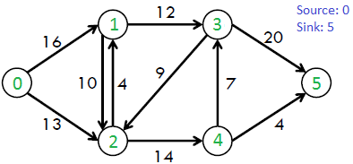
Problem Definition
Given a graph which represents a flow network where every edge has a capacity.
Also, given two vertices source ‘s’ and sink ‘t’ in the graph, find the maximum possible flow from s to t with the following constraints:
Flow on an edge doesn’t exceed the given capacity of the edge.
Incoming flow is equal to outgoing flow for every vertex except s and t.
Incoming flow to s is zero.
Outgoing flow from t is zero.

Slide 7
Ford-Fulkerson - Pseudocode
The following is simple idea of Ford-Fulkerson algorithm:
Start with initial flow as 0.
While there exists an augmenting path from the source to the sink:
a. Find an augmenting path using any path-finding algorithm, such as depth-first search.
b. Determine the amount of flow that can be sent along the augmenting path, which is the minimum residual capacity along the edges of the path.
c. Increase the flow along the augmenting path by the determined amount.
Return the maximum flow.

Slide 8
Implementation of Ford-Fulkerson algorithm
Residual Graph of a flow network is a graph which indicates additional possible flow.
If there is a path from source to sink in residual graph, then it is possible to add flow.
Every edge of a residual graph has a value called residual capacity which is equal to original capacity of the edge minus current flow.
Residual capacity is basically the current capacity(residual) of the edge.

Slide 9
Implementation of Ford-Fulkerson algorithm
In the residual network, every edge has a residual capacity, which is the original capacity of the edge, minus the flow in that edge.
The residual capacity can be seen as the leftover capacity in an edge with some flow.
For example, if there is a flow of 2 in the v3→v4 edge, and the capacity is 3, the residual flow is 1 in that edge, because there is room for sending 1 more unit of flow through that edge.
Residual capacity is 0 if there is no edge between two vertices of residual graph.
We can initialize the residual graph as original graph as there is no initial flow and initially residual capacity is equal to original capacity.
To find an augmenting path, we can either do a BFS or DFS of the residual graph.
Using BFS, we can find out if there is a path from source to sink. (Edmond-Carp Technique)
BFS also builds parent[] array.
Using the parent[] array, we traverse through the found path and find possible flow through this path by finding minimum residual capacity along the path.
We later add the found path flow to overall flow.
We need to update residual capacities in the residual graph.
We subtract path flow from all edges along the path and we add path flow along the reverse edges
We add path flow along reverse edges because may later need to send flow in reverse direction

Slide 10
Reversed Edges in Ford-Fulkerson
The Ford-Fulkerson algorithm also uses something called reversed edges to send flow back. This is useful to increase the total flow.
For example, the last augmented path s→v2→v4→v3→t shows how the total flow is increased by one more unit, by actually sending flow back on edge v4→v3, sending the flow in the reverse direction.
Sending flow back in the reverse direction on edge v3→v4 means that this 1 unit of flow going out of vertex v3, now leaves v3 on edge v3→t instead of v3→v4.
To send flow back, in the opposite direction of the edge, a reverse edge is created for each original edge in the network.
The Ford-Fulkerson algorithm can then use these reverse edges to send flow in the reverse direction.
A reversed edge has no flow or capacity, just residual capacity. The residual capacity for a reversed edge is always the same as the flow in the corresponding original edge.

Slide 11
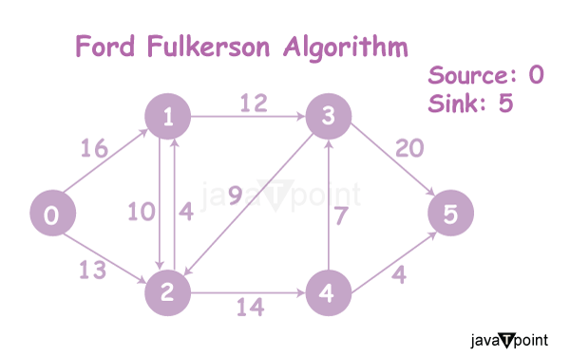

Slide 12
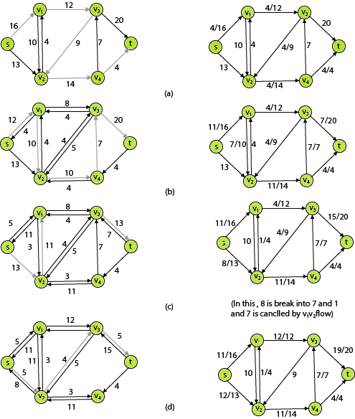
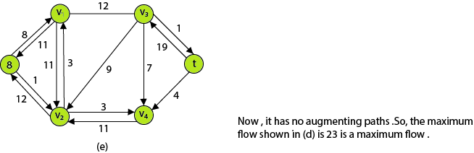
The left side of each part shows the residual network G_{f} with a shaded augmenting path p,and the right side of each part shows the net flow f.

Slide 13
Cut in a Flow Diagram
In general, a cut is a set of edges whose removal divides a connected graph into two disjoint subsets.
There are two variations of a cut: maximum cut and minimum cut.
Let’s assume a cut CT(S, T) partition the vertex set V into two sets S, and T.
The net flow f(S, T) of a cut CT(S, T) can be defined as the sum of flow f(u, v), where u, v are two nodes ∈ V, and u ∈ S, v ∈ T.
Similarly, the capacity C(u, v) of a cut CT(S, T) is the sum of the individual capacities, where u, v are two nodes ∈ V, and u ∈ S, v ∈ T.
The minimum cut of a weighted graph is defined as the minimum sum of weights of edges that, when removed from the graph, divide the graph into two sets.

Slide 14
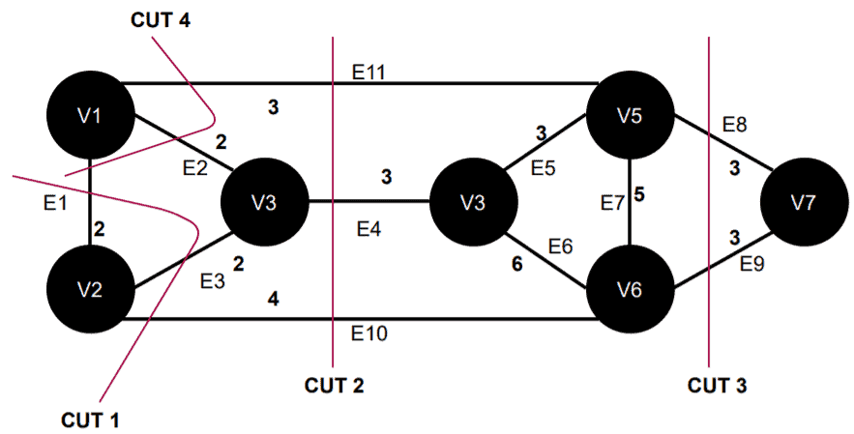
Example
Here in this graph, CUT 3 is an example of a minimum cut.
It removes the edges E8 and E9, and the sum of weights of these two edges are minimum among all other cuts in this graph.

Slide 15
Max Flow –Min Cut Theorem
The max-flow min-cut theorem states that the maximum flow through any network from a given source to a given sink is exactly equal to the minimum sum of a cut.
This theorem can be verified using the Ford-Fulkerson algorithm. This algorithm finds the maximum flow of a network or graph.
Let’s define the max-flow min-cut theorem formally.
Let G=(X,A) be a flow network, φ a flow on G.
The value of the maximum flow from the source S to the sink P is equal to the capacity of the minimum cut CT separating S and P:

Slide 16
Time-Complexity Analysis
The Ford-Fulkerson algorithm depends heavily on the method used to find an augmented path.
An augmented path can be found using a Breadth-first search (BFS) or Depth-first search (DFS).
If we choose an augmented path using BFS or DFS, the algorithm runs in polynomial time.
The execution time of BFS is equal to O(E'), where E' is the number of edges in the residual graph G_{f}.
For each edge, the flow will be increased, and in the worst case, it reaches its maximum flow value f*.
Therefore, the algorithm will be iterated at most f* times.
Hence, the overall time complexity of the Ford-Fulkerson algorithm would be O(f* x E').

Slide 17
Minimum-cost flow – Cycle Cancellation Algorithm
Given a network G consisting of n vertices and m edges.
For each edge (generally speaking, oriented edges), the capacity (a non-negative integer) and the cost per unit of flow along this edge (some integer) are given.
Also the source s and the sink t are marked.
For a given value K , we have to find a flow of this quantity, and among all flows of this quantity we have to choose the flow with the lowest cost. This task is called minimum-cost flow problem.
Sometimes the task is given a little differently:
Find the maximum flow, and among all maximal flows we want to find the one with the least cost. This is called the minimum-cost maximum-flow problem.

Slide 18
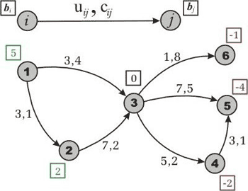
Minimum-Cost Flow- Graph Representation
Let G =(V,E) be a directed network defined by a set V of vertexes (nodes) and set E of edges (arcs).
For each edge (i,j) ∈ E we associate a capacity u_{ij} that denotes the maximum amount that can flow on the edge.
Each edge (i,j) ∈ E also has an associated cost c_{ij} that denotes the cost per unit flow on that edge.
We associate with each vertex i ∈ V a number b_{i}. This value represents supply/demand of the vertex.
If b_{i} > 0, node i is a supply node;
if b_{i} < 0, node i is a demand node (its demand is equal to -b_{i}).
We call vertex i a transshipment if b_{i} is zero.
For simplification, let’s call G a transportation network and write in case we want to show all the network parameters explicitly.
Figure . An example of the transportation network.
In this there are 2 supply vertexes (with supply values 5 and 2),
3 demand vertexes(with demand values 1, 4 and 2),
and 1 transshipment node.
Each edge has two numbers, capacity and cost, separated by comma.

Slide 19

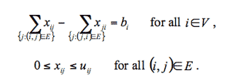
Representing the flow on arc (i,j) ∈ E by x_{ij}, the optimization model for the minimum cost flow problem:
subject to the following :
The first constraint states that the total outflow of a node minus the total inflow of the node must be equal to mass balance (supply/demand value) of this node.
This is known as the mass balance constraints.
Next, the flow bound constraints model physical capacities or restrictions imposed on the flow’s range.
This optimization model describes a typical relationship between warehouses and shops.
for example, in a case where we have only one kind of product. We need to satisfy the demand of each shop by transferring goods from the subset of warehouses, while minimizing the expenses on transportation.

Slide 20

If
then the problem has no solution, because either the supply or the demand dominates in the network and the mass balance constraints come into play.
We can easily avoid this situation, if we add a special node r with the supply/demand value .
Now we have two options:
If (supply dominates)
then for each node with b_{i} > 0 we add an arc (r,i) with infinite capacity and zero cost;
otherwise (demand dominates), for each node with b_{i} < 0, we add an arc (r,i) with the same properties.
Now we have a new network with
— and it is easy to prove that this network has the same optimal value as the objective function.
Consider the vertex r as a rubbish or scrap dump.
If the shops demand is less than what the warehouse supplies, then we have to eject the useless goods as rubbish. Otherwise, we take the missing goods from the dump.

Slide 21
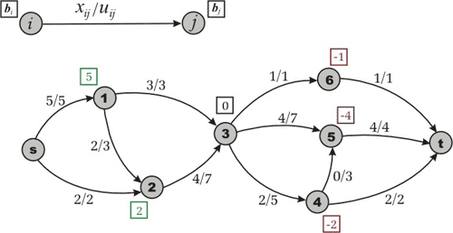
Even if we have
we are not sure that the edge’s capacities allow us to transfer enough flow from supply vertexes to demand ones.
To determine if the network has a feasible flow, we want to find any transfer way what will satisfy all the problem’s constraints.
Let us introduce a source node s and a sink node t.
For each node
with b_{i} > 0, we add a source arc (s,i) to G with capacity b_{i} and cost 0.
For each node
with b_{i} < 0, we add a sink arc (i,t) to G with capacity -b_{i} and cost 0.
Figure. Maximum flow in the transformed network.
For simplicity we are ignoring the costs.
The new network is called a transformed network.
Solve a maximum flow problem from s to t (ignoring costs,).
If the maximum flow saturates all the source and sink arcs, then the problem has a feasible solution;
otherwise, it is infeasible.

Slide 22
Assumptions
Having found a maximum flow,
we can now remove source, sink, and all adjacent arcs and obtain a feasible flow in G.
How do we detect whether the flow is optimal or not? Does this flow minimize costs of the objective function z?
For this we have the following assumptions.
Assumption 1. All data (u_{ij}, c_{ij}, b_{i}) are integral.
Assumption 2. The network is directed.
Assumption 3. All costs associated with edges are nonnegative.
Assumption 4. The supply/demand at the vertexes satisfy the condition
and the minimum cost flow problem has a feasible solution.

Slide 23
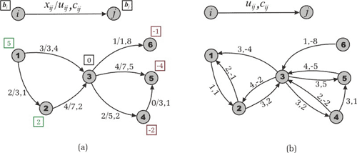
Residual Network
Consider the concept of residual networks from the perspective of min-cost flow theory.
Let G be a network and x be a feasible solution of the minimum cost flow problem.
Suppose that an edge (i,j) in E carries x_{ij} units of flow.
We define the residual capacity of the edge (i,j) as r_{ij} = u_{ij} – x_{ij}.
This means that we can send an additional r_{ij} units of flow from vertex i to vertex j.
We can also cancel the existing flow x_{ij} on the arc if we send up x_{ij} units of flow from j to i over the arc (i,j).
Now note that sending a unit of flow from i to j along the arc (i,j) increases the objective function by c_{ij}, while sending a unit of flow from j to i on the same arc decreases the flow cost by c_{ij}.
Figure . The transportation network
(a) A feasible solution.
(b) The residual network with respect to the found feasible solution.

Slide 24
Based on these ideas we define the residual network with respect to the given flow x as follows.
Suppose we have a transportation network G = (V,E).
A feasible solution x engenders a new (residual) transportation network, which we are used to defining by G_{x} = (V,E_{x}), where E_{x} is a set of residual edges corresponding to the feasible solution x.
What is E_{x}?
We replace each arc (i,j) in E by two arcs (i,j), (j,i):
the arc (i,j) has cost c_{ij} and (residual) capacity r_{ij} = u_{ij} – x_{ij},
and the arc (j,i) has cost -c_{ij} and (residual) capacity r_{ji}=x_{ij}.
Then we construct the set E_{x} from the new edges with a positive residual capacity. Look at Figure to make sure that you understand the construction of the residual network.
Figure . The transportation network
(a) A feasible solution.
(b) The residual network with respect to the found feasible solution.

Slide 25

Cycle Cancelling Algorithm
Theorem 1 (Solution Existence). Let G be a transportation network.
Suppose that G contains no uncapacitated negative cost cycle and there exists a feasible solution of the minimum cost flow problem. Then the optimal solution exists.
Theorem 2 (Negative Cycle Optimality Conditions). Let x* be a feasible solution of a minimum cost flow problem. Then x* is an optimal solution if and only if the residual network G_{x*} contains no negative cost (directed) cycle.
This theorem provides the cycle-canceling algorithm for solving the minimum cost flow problem.
First, we use any maximum flow algorithm to establish a feasible flow in the network (assumption 4).
Then the algorithm attempts to improve the objective function by finding negative cost cycles in the residual network and augmenting the flow on these cycles.
Let us specify a program in pseudo code
1 Establish a feasible flow x in the network
2 while ( Gx contains a negative cycle ) do
3 identify a negative cycle W
4
5 augment units of flow along the cycle W
6 update G_{x}

Slide 26
How many iterations does the algorithm perform?
First, note that due to assumption 1 all the data is integral.
After line 1 of the program, we have an integral feasible solution x.
It implies the integrality of Gx.
In each iteration of the cycle in line 2 the algorithm finds the minimum residual capacity in the found negative cycle.
In the first iteration δ will be an integer.
Therefore, the modified residual capacities will be integers, too.
And in all subsequent iterations the residual capacities will be integers again.
Theorem 3 (Integrality Property). If all edge capacities and supplies/demands on vertexes are integers, then the minimum cost flow problem always has an integer solution.
The cycle-canceling algorithm works in cases when the minimum cost flow problem has an optimal solution and all the data is integral and we don’t need any other assumptions.

Slide 27
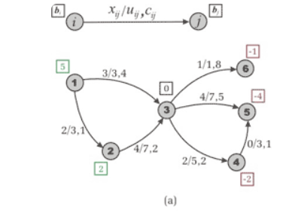
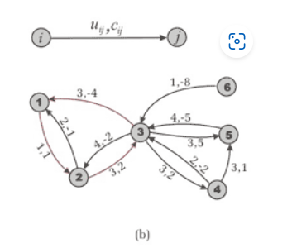
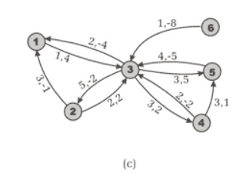
Figure . Cycle-Canceling Algorithm, example of the network from earlier Figure.
We have a feasible solution of cost 54.
A negative cycle 1-2-3-1 is detected in the residual network. Its cost is -1 and capacity is 1.
The residual network after augmentation along the cycle.

Slide 28
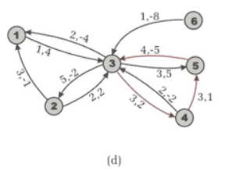
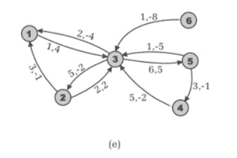
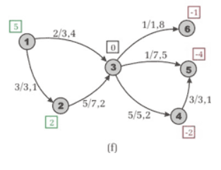
(d) Another negative cost cycle 3-4-5-3 is detected. It has cost -2 and capacity 3.
(e) The residual network after augmentation. It doesn’t contain negative cycles.
(f) Optimal flow cost value is equal to 47.

Slide 29
Bipartite Matching

Slide 30
Matching of a Graph
In the mathematical discipline of graph theory, a matching or independent edge set in an undirected graph is a set of edges without common vertices.[
Given a graph G = (V, E), a matching M in G is a set of pairwise non-adjacent edges, none of which are loops; that is, no two edges share common vertices.
A vertex is matched (or saturated) if it is an endpoint of one of the edges in the matching. Otherwise the vertex is unmatched (or unsaturated).

Slide 31
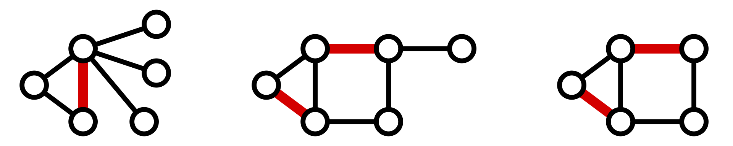
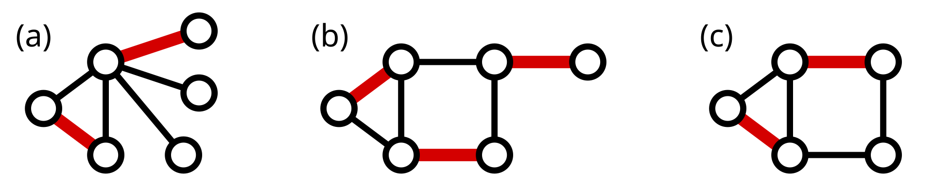
Maximal and Maximum Matching
A maximal matching is a matching M of a graph G that is not a subset of any other matching.
A matching M of a graph G is maximal if every edge in G has a non-empty intersection with at least one edge in M.
The following figure shows examples of maximal matchings (red) in three graphs.
A maximum matching (also known as maximum-cardinality matching) is a matching that contains the largest possible number of edges. There may be many maximum matchings.
The matching number ν(G) of a graph G is the size of a maximum matching.
Every maximum matching is maximal, but not every maximal matching is a maximum matching.
The following figure shows examples of maximum matchings in the same three graphs.

Slide 32
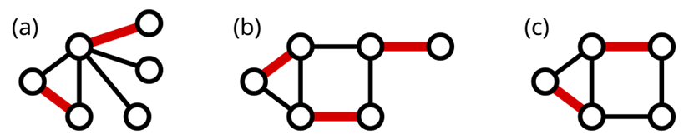
Perfect Matching
A perfect matching is a matching that matches all vertices of the graph. That is, a matching is perfect if every vertex of the graph is incident to an edge of the matching.
A matching is perfect if |M|=|V|/2
Every perfect matching is maximum and hence maximal.
In some literature, the term complete matching is used. In the below figure, only part (b) shows a perfect matching.
A perfect matching is also a minimum-size edge cover.
Thus, the size of a maximum matching is no larger than the size of a minimum edge cover: ⁠
ν(G)≤ρ(G)
A graph can only contain a perfect matching when the graph has an even number of vertices.
A near-perfect matching is one in which exactly one vertex is unmatched.
Clearly, a graph can only contain a near-perfect matching when the graph has an odd number of vertices, and near-perfect matchings are maximum matchings.
In the above figure, part (c) shows a near-perfect matching.
If every vertex is unmatched by some near-perfect matching, then the graph is called factor-critical.

Slide 33
Alternate Path in Matching
Given a matching M, an alternating path is a path that begins with an unmatched vertex and whose edges belong alternately to the matching and not to the matching.
An augmenting path is an alternating path that starts from and ends on free (unmatched) vertices.
Berge's lemma states that a matching M is maximum if and only if there is no augmenting path with respect to M.
An induced matching is a matching that is the edge set of an induced subgraph.

Slide 34




Bipartite Graphs
People
Tasks
Suppose we have a set of people L and set of jobs R.
x
Person u can do task x
Each person can do only some of the jobs.
u
Can model this as a bipartite graph →
L
R

Slide 35
Bipartite Matching
People
Tasks
A matching gives an assignment of people to tasks.
a
1
Want to get as many tasks done as possible.
b
2
c
3
So, want a maximum matching: one that contains as many edges as possible.
d
4
e
5
(This one is not maximum.)
L
R

Slide 36
Maximum Bipartite Matching
Maximum Bipartite Matching
Given a bipartite graph G = (A ∪ B, E ), find an S ⊆ A × B that is a matching and is as large as possible.
Notes:
We’re given A and B so we don’t have to find them.
S is a perfect matching if every vertex is matched.
Maximum is not the same as maximal: greedy will get to maximal.

Slide 37

Reduce
Given an instance of bipartite matching,
Instance of Maximum Bipartite Matching
Create an instance of network flow.
transform, aka reduce
Where the solution to the network flow problem can easily be used to find the solution to the bipartite matching.
Instance of Network Flow

Slide 38
Reducing Bipartite Matching to Net Flow
People
Tasks
a
1
b
2
c
3
d
4
e
5
L
R

Slide 39
Reducing Bipartite Matching to Net Flow
People
Tasks
a
1
b
2
c
3
d
4
e
5
L
R

Slide 40
Reducing Bipartite Matching to Net Flow
People
Tasks
a
1
b
2
t
s
c
3
d
4
e
5
L
R

Slide 41
Reducing Bipartite Matching to Net Flow
People
Tasks
a
1
1
1
1
1
1
b
2
1
1
1
1
t
s
1
c
1
3
1
1
1
1
d
1
4
1
1
e
1
5
L
R

Slide 42
Using Net Flow to Solve Bipartite Matching
To Recap:
Given bipartite graph G = (A ∪ B, E ), direct the edges from A to B.
Add new vertices s and t.
Add an edge from s to every vertex in A.
Add an edge from every vertex in B to t.
Make all the capacities 1.
Solve maximum network flow problem on this new graph G'.
The edges used in the maximum network flow will correspond to the largest possible matching!

Slide 43
Analysis, Notes
Because the capacities are integers, our flow will be integral.
Because the capacities are all 1, we will either:
use an edge completely (sending 1 unit of flow) or
not use an edge at all.
Let M be the set of edges going from A to B that we use.
We will show that
M is a matching
M is the largest possible matching

Slide 44






M is a matching
We can choose at most one edge leaving any node in A. We can choose at most one edge entering any node in B.
People Tasks
a
1
1
1
1
1
1
b
2
1
1
1
If we chose more than 1, we couldn’t have balanced flow.
s
1
c
1
3
1
t
1
1
1
1
d
1
4
1
1
e
1
5
L
R

Slide 45





Correspondence between flows and matchings
If there is a matching of k edges, there is a flow f of value k.
a
1
b
2
s
c
3
t
d
4
If there is a flow f of value k, there is a matching with k edges.
B
A
e
5
v(f) = f^{out}(A) - f^{in}(A)

Slide 46
Correspondence between flows and matchings
If there is a matching of k edges, there is a flow f of value k.
f has 1 unit of flow across each of the k edges.
≤ 1 unit leaves & enters each node (except s, t)
If there is a flow f of value k, there is a matching with k edges.
a
1
b
2
s
c
3
t
d
4
B
A
e
5
v(f) = f^{out}(A) - f^{in}(A)

Slide 47
M is as large as possible
We find the maximum flow f (say with k edges).
This corresponds to a matching M of k edges.
If there were a matching with > k edges, we would have found a flow with value > k, contradicting that f was maximum.
Hence, M is maximum.

Slide 48
Running Time
How long does it take to solve the network flow problem on
G'?
The running time of Ford-Fulkerson is O(m'C ) where m' is the number of edges, and C = ^{Σ} c_{e} .
e leaving s
C = |A| = n.
The number of edges in G' is equal to number of edges in G
(m) plus 2n.
So, running time is O((m + 2n)n) = (mn + n²) = O(mn)
Theorem
We can find maximum bipartite matching in O(mn) time.

Slide 49
Summary: Bipartite Matching
Instance of Maximum Bipartite Matching
Fold-Fulkerson can find a maximum matching in a bipartite graph in O(mn) time.
transform, aka reduce
We do this by reducing the problem of maximum bipartite matching to network flow.
Instance of Network Flow

Slide 50
Berge’s Lemma
Berge's lemma
This lemma was proven by the French mathematician Claude Berge in 1957,
although it already was observed by the Danish mathematician Julius Petersen in 1891
and the Hungarian mathematician Denés Kőnig in 1931.
Formulation
A matching M is maximum ⬄ there is no augmenting path relative to the matching M.

Slide 51
Kuhn’s Algorithm
Kuhn's algorithm is a direct application of Berge's lemma. It is essentially described as follows:
First, we take an empty matching.
Then, while there is an augmenting path,
we update the matching by alternating it along this path
and repeat the process of finding the augmenting path.
As soon as it is not possible to find such a path, we stop the process
the current matching is the maximum.
Kuhn's algorithm simply searches for any of these paths using depth-first or breadth-first traversal.
The algorithm looks through all the vertices of the graph in turn, starting each traversal from it, trying to find an augmenting path starting at this vertex.

Slide 52
Max Flow- Assignment
The Indian Premier League (IPL in short) is a professional club cricket league played by 8 teams in India. The tournament is divided into two main stages, which are the group stage and the playoffs. The top 4 teams qualify for the playoffs.
We will limit our scenario to just the group stage, and define our problem statement as:
Which teams have a chance of finishing the season with the most wins?
While the teams in the IPL play only 16 games in the group stages and it may be fairly easy to figure out which team cannot finish with the most wins just by observation,
we will extend the number of games each team plays to 162.
Also, for simplicity, I am cutting down the number of teams contending to just 4.
Consider the following league table towards the end of the season. We want to figure out which teams are eliminated from finishing first (not eliminated from qualifying for the playoffs — don’t be confused).

Slide 53
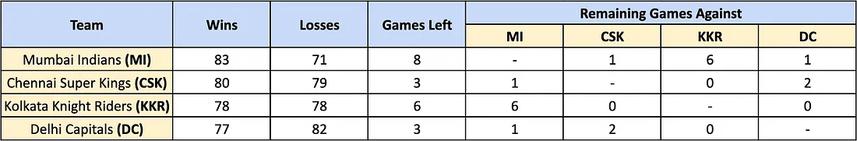
IPL League Table
The above table shows the 4 teams:
Mumbai Indian (MI), Chennai Super Kings (CSK), Kolkata Knight Riders (KKR), & DC.
It shows the win/loss record for each team, the number of games each team has left, and who these remaining games are to be played against.
We now, want to determine which of the teams is eliminated from the race to finish first.

Slide 54
We have:
set of teams S
a particular team z in set S
team x has won w_x games (for all teams x other than w)
teams x and y have to play each other r_xy times more (for all teams x, y (x != y) other than w)
Refined Problem Statement:
we want to see if given a scenario of the standings, can team z finish with the most number of wins
(can be tied as well)?

Slide 55
Let us now reduce the Cricket Elimination problem so that it can be represented by a Flow Graph:
First, consider team z.
Assume team z wins all their remaining games, giving them a win total of w_z + r_z.
We have arbitrary source and sink nodes: s and t
Add edges from s to “game” nodes, which represent the games left between team x and team y. These edges have capacity r_xy (as defined earlier). (This is for all teams barring team z.)
Add edges between the game nodes and the team nodes for the games that correspond to a particular team. So each game node should have exactly two outgoing edges.
The capacities on the edges must be set to infinity. This is for all teams barring team z.
Lastly, we add edges from the team nodes to the sink node t. These edges will have capacity w_z + r_z — w_x. This indicates the number of games that team x can still win so that team z still ends up first.
For the example given in the table above, and for CSK as team z (w_CSK + r_CSK = 83), the flow network looks like:

Slide 56
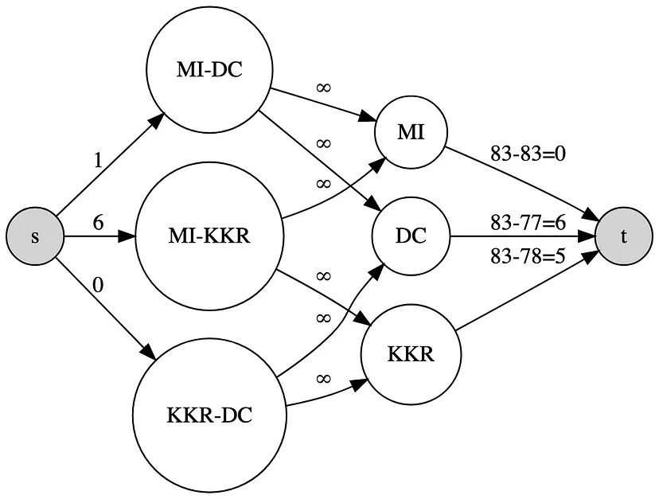

Slide 57
We have drawn out our reduction, but we still have not answered our question.
How does the above reduction tell us that CSK is indeed eliminated?
The theorem that validates this reduction states that: team z is eliminated if and only the max flow saturates all edges leaving the source node s.
While I won’t dive into the math behind the proof of this theorem, I will give a brief overview of it. The way in which we set up the flow graph ensures the following:
All the remaining games between teams x and y (other than team z) are added to the number of wins for x AND y (infinite edge capacities).
Capacity on the (x, t) edges ensures that no team wins too many games, preventing team z from winning.

Slide 58
Now, to check if CSK is eliminated, all we have to do is run the Ford-Fulkerson Algorithm for max flow on the graph above. the nodes and the edge are entered manually here because our example is fairly small,
but this process can be easily automated.
Do the same for the rest of the teams.

Slide 59
Thank You

